Slide 1
Binomial and Geometric Distributions
Bernoulli Trials
Binomial Model
Geometric Model
Lecture 12
February 27, 2024
Sections 6.4 – 6.5
Notes:
48

Slide 2
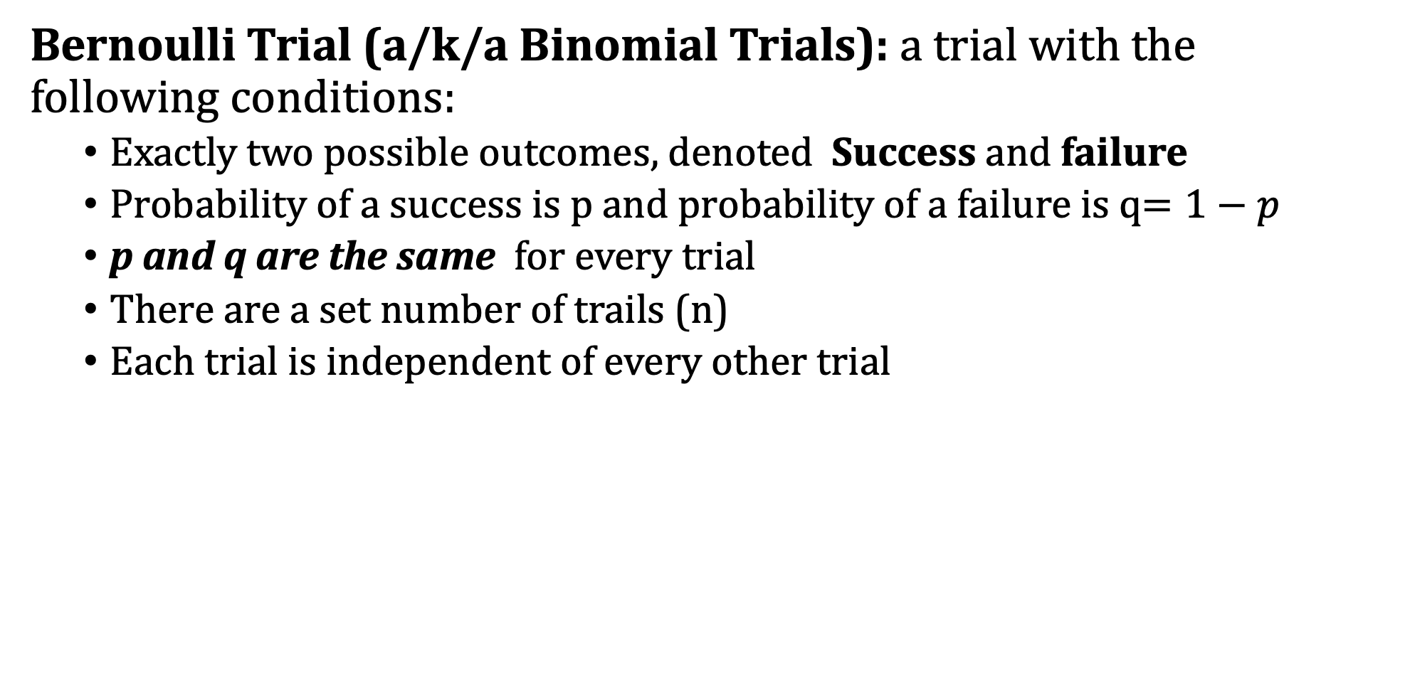
Bernoulli Trial
Bernoulli Trial (a/k/a Binomial Trials): a trial with the following conditions:
Exactly two possible outcomes, denoted Success and failure
Probability of a success is p and probability of a failure is q$=1−p$
p and q are the same for every trial
There are a set number of trails (n)
Each trial is independent of every other trial
Note: If sampling from a finite population, trials can be considered independent if the sample is less than 10% of the size of the population.

Slide 3
Example: Bernoulli Trials
Question: Which of the following are Bernoulli trials?
Flipping a fair coin 5 times
Pulling 3 marbles without replacement from a bucket with 6 blue marbles and 6 red marbles
Asking 10 random people on the street what state they are from
Asking 10 random people on the street if they are from Pennsylvania
Answer:
__Yes: two outcomes with p = .50, q = .50 and independent trials
__No: two outcomes, but trials are not independent so p and q change
__No: 50 possible outcomes
__Yes: Two outcomes (from PA or not) and sample is less than 10% of population size.

Slide 4
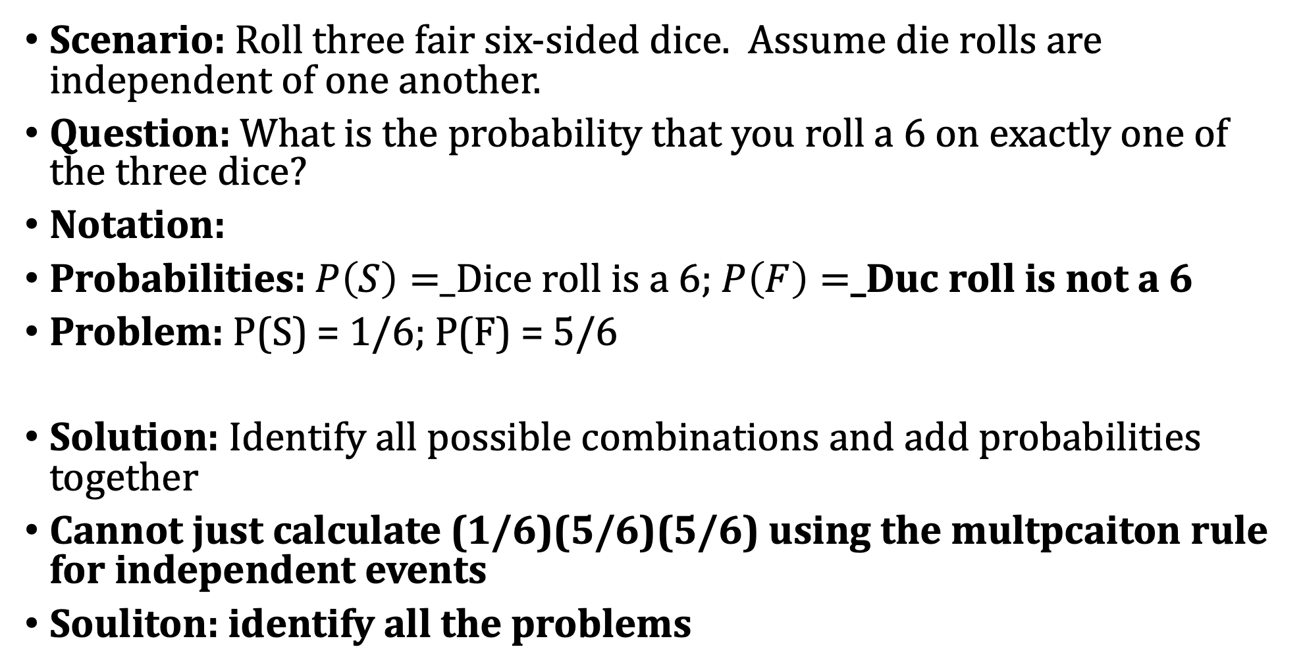
Motivation: Binomial Model
Scenario: Roll three fair six-sided dice. Assume die rolls are independent of one another.
Question: What is the probability that you roll a 6 on exactly one of the three dice?
Notation:
Probabilities: $P\left(S\right)=$_Dice roll is a 6; $P\left(F\right)=$_Duc roll is not a 6
Problem: P(S) = 1/6; P(F) = 5/6
Solution: Identify all possible combinations and add probabilities together
Cannot just calculate (1/6)(5/6)(5/6) using the multpcaiton rule for independent events
Souliton: identify all the problems

Slide 5
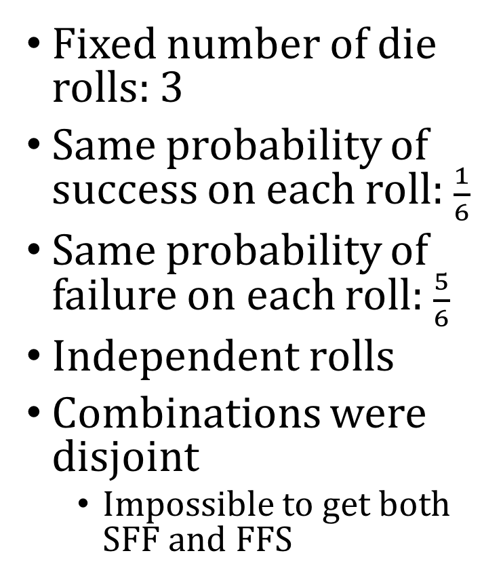
Motivation: Binomial Model
Combinations
Probability
Observations
Fixed number of die rolls: 3
Same probability of success on each roll: $\frac{1}{6}$
Same probability of failure on each roll: $\frac{5}{6}$
Independent rolls
Combinations were disjoint
Impossible to get both SFF and FFS
SFF
(1/6)(5/6)(5/6)
.116
+
Disjoint
FSF
(5/6)(1/6)(5/6)
.116
+
(5/6)(5/6)(1/6)
.116
FFS
Addition Rule for Disjoint Events
=
3(1/6)(5/6)^2
.348
=

Slide 6
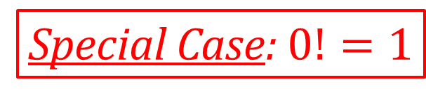
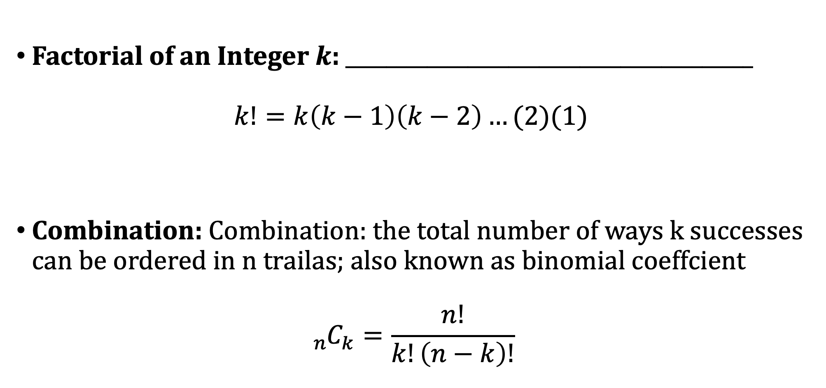
Factorials and Combinations
Factorial of an Integer $k$: ________________________________________
$$k!=k\left(k−1\right)\left(k−2\right)…(2)(1)$$
Combination: Combination: the total number of ways k successes can be ordered in n trailas; also known as binomial coeffcient
$${{}_{n}^{}C}_{k}=\frac{n!}{k!\left(n−k\right)!}$$
Special Case: $0!=1$

Slide 7
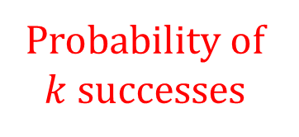
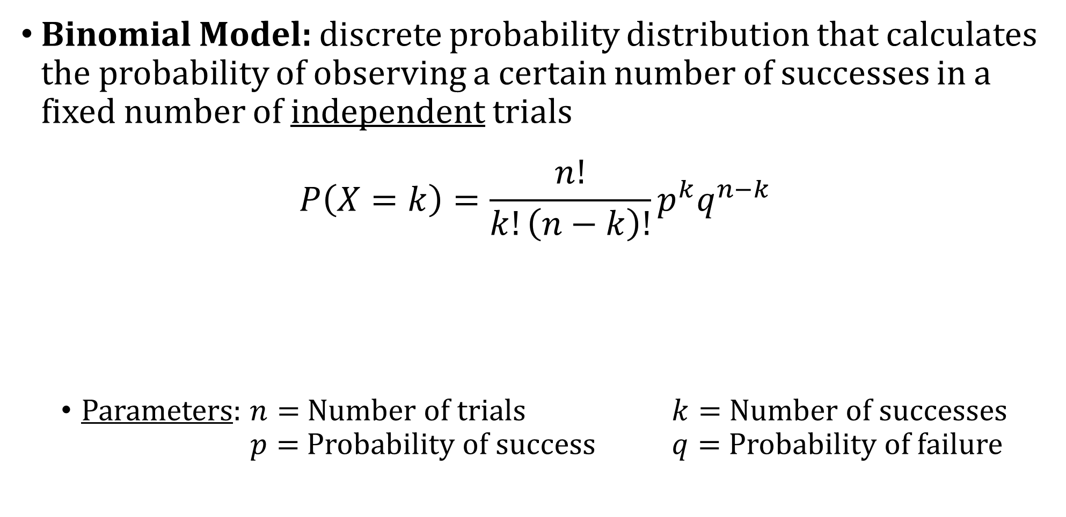
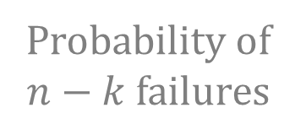
Binomial Model
Binomial Model: discrete probability distribution that calculates the probability of observing a certain number of successes in a fixed number of independent trials
$$P\left(X=k\right)=\frac{n!}{k!\left(n−k\right)!}p^{k}q^{n−k}$$
Parameters: $n=$ Number of trials $k=$ Number of successes $p=$ Probability of success $q=$ Probability of failure
Binomial random variable
Probability of $n−k$ failures
Binomial Coefficient:
Number of combinations
Probability of $k$ successes

Slide 8
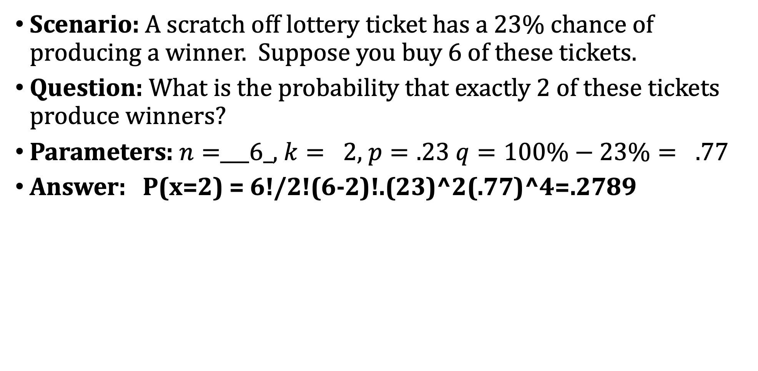
Example: Binomial Model
Scenario: A scratch off lottery ticket has a 23% chance of producing a winner. Suppose you buy 6 of these tickets.
Question: What is the probability that exactly 2 of these tickets produce winners?
Parameters: $n=$___6_, $k= 2$, $p=.23$ $q=100\%−23\%= .77$
Answer: P(x=2) = 6!/2!(6-2)!.(23)^2(.77)^4=.2789

Slide 9
Example: Binomial Model
Scenario: 57% of all college students are female. Randomly sample 8 students independently.
Question: What is the probability that more than 6 of the selected students are female?
Parameters:
Answer:
P(x>6)=P(x=7)+P(x=8)
=8!/7!(8-7)!.(57)
Binominal on the calcuatle

Slide 10
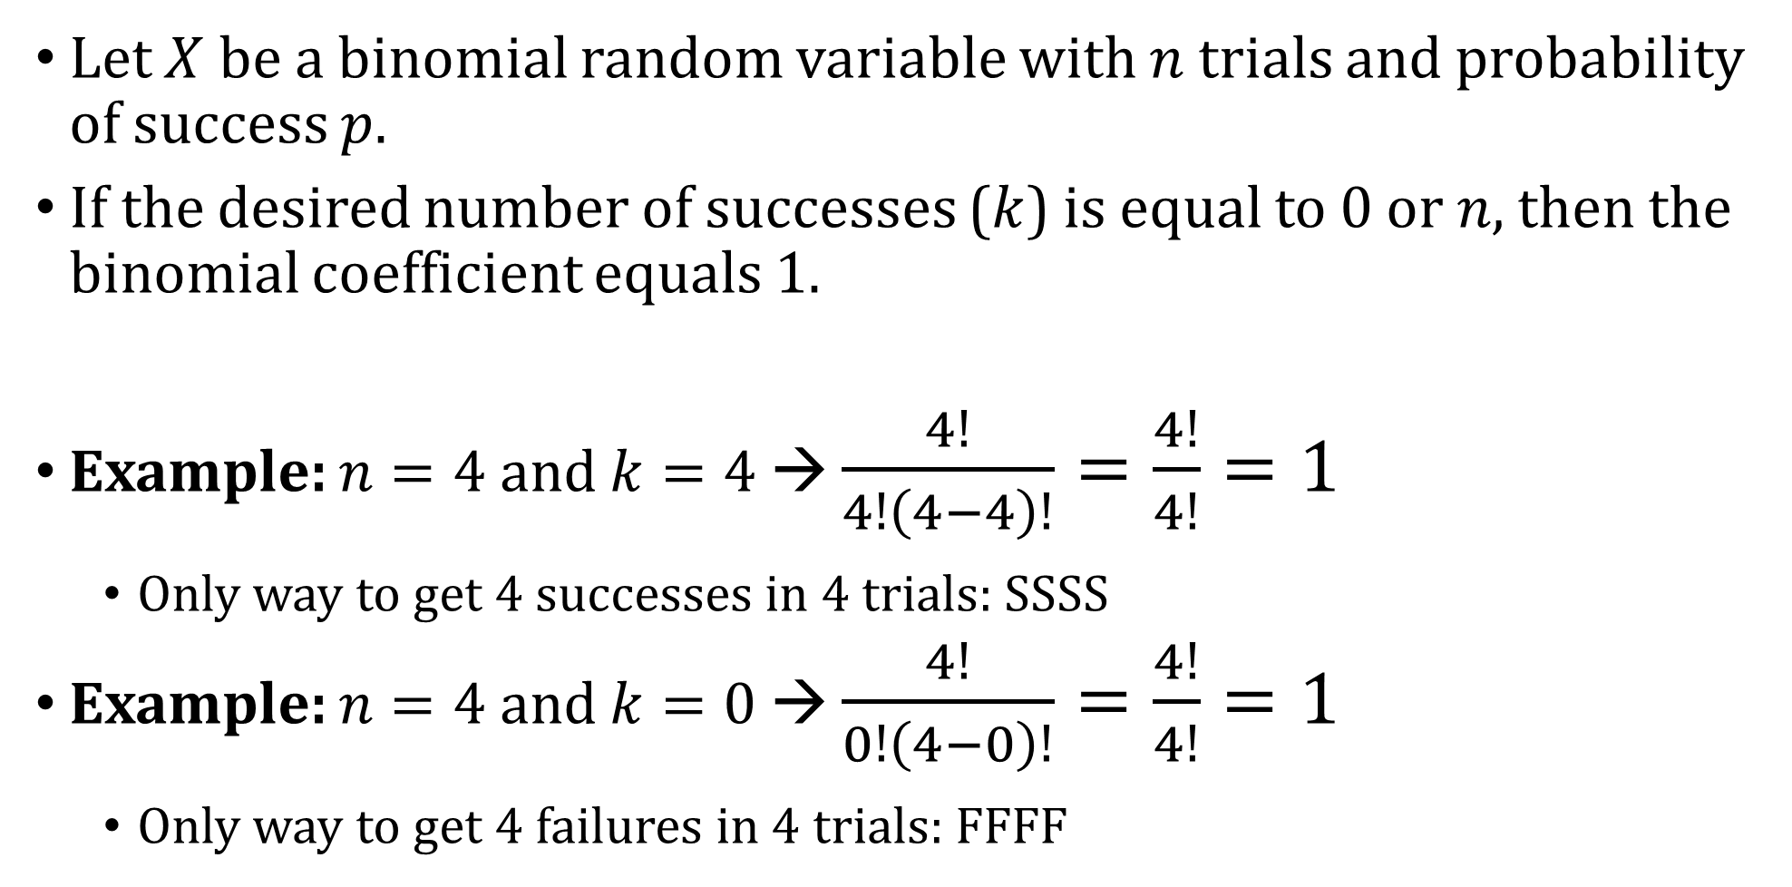
Simplifying the Binomial Coefficient
Let $X$ be a binomial random variable with $n$ trials and probability of success $p$.
If the desired number of successes ($k$) is equal to 0 or $n$, then the binomial coefficient equals 1.
Example: $n=4$ and $k=4$ → $\frac{4!}{4!\left(4−4\right)!}=\frac{4!}{4!}=1$
Only way to get 4 successes in 4 trials: SSSS
Example: $n=4$ and $k=0$ → $\frac{4!}{0!\left(4−0\right)!}=\frac{4!}{4!}=1$
Only way to get 4 failures in 4 trials: FFFF

Slide 11
Example: Binomial Model
Scenario: 10% of the world’s population is left-handed. Randomly sample 12 people.
Question: What is the probability that at least one person from the sample is left-handed?
Parameters: n = 12, k>- 1, p = .10, q=.90
Answer: P (x>_1) = 1 – P(X=0

Slide 12
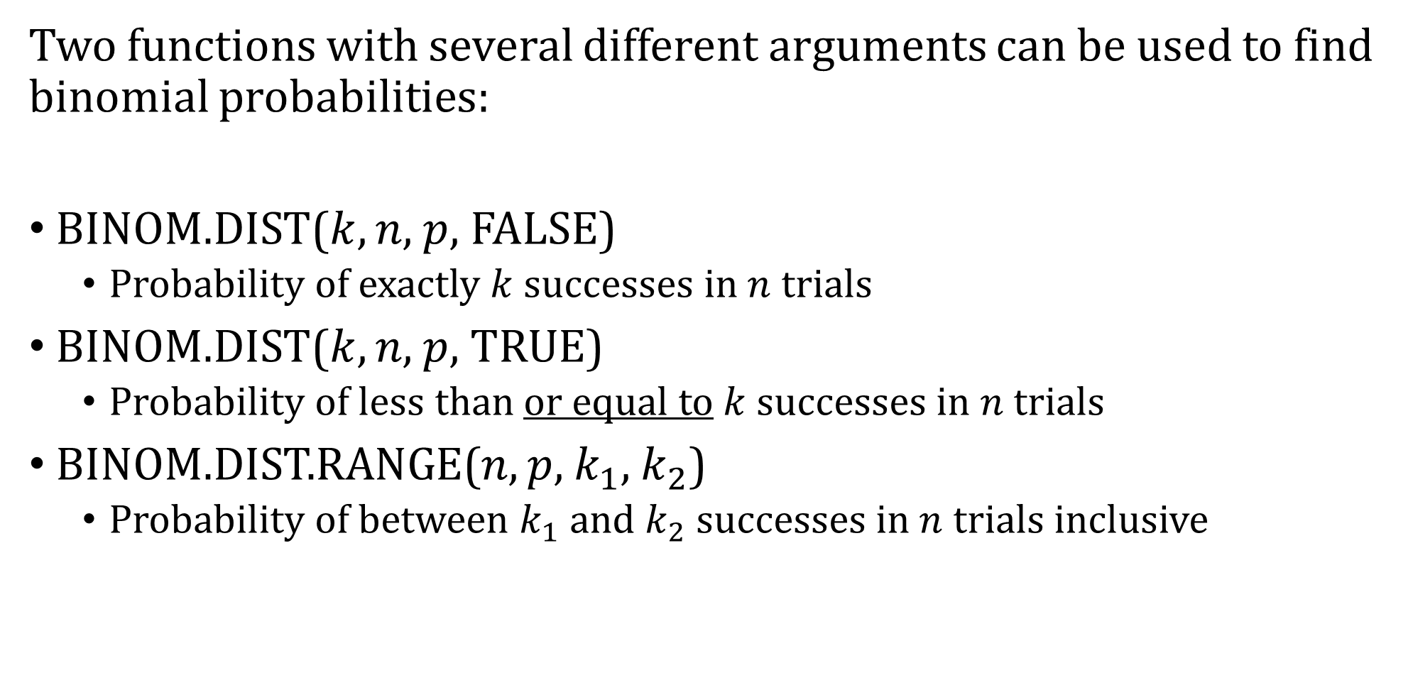
Using Excel
Two functions with several different arguments can be used to find binomial probabilities:
BINOM.DIST($k$, $n$, $p$, FALSE)
Probability of exactly $k$ successes in $n$ trials
BINOM.DIST($k$, $n$, $p$, TRUE)
Probability of less than or equal to $k$ successes in $n$ trials
BINOM.DIST.RANGE($n$, $p$, $k_{1}$, $k_{2}$)
Probability of between $k_{1}$ and $k_{2}$ successes in $n$ trials inclusive

Slide 13
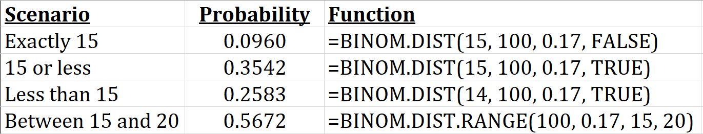
Example: Using Excel
Scenario: 17% of all Americans smoke cigarettes. Randomly sample 100 Americans.
Question: Using Excel, what are the probabilities that:
Exactly 15 people smoke?
15 people or less smoke?
Less than 15 people smoke?
Between 15 and 20 people (inclusive) smoke?
Answer:
0.0960

Slide 14
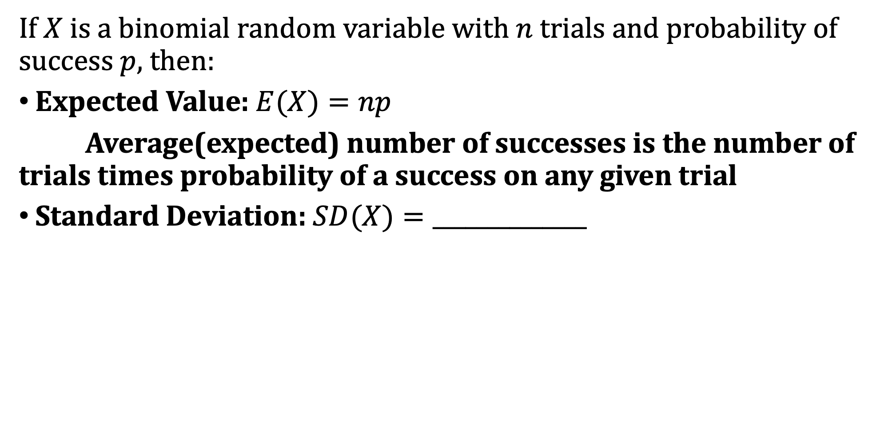
Mean and Standard Deviation
If $X$ is a binomial random variable with $n$ trials and probability of success $p$, then:
Expected Value: $E(X)=np$
Average(expected) number of successes is the number of trials times probability of a success on any given trial
Standard Deviation: $SD(X)=______________$

Slide 15
Example: Mean and Standard Deviation
Scenario: Flip a coin 200 times and count the number of heads.
Question: If the coin is fair, what is the mean number of heads that appear in 200 flips?
Answer:
Question: What is the standard deviation of the number of heads that appear in 200 flips?
Answer:

Slide 16
Example: Mean and Standard Deviation
Scenario: Suppose you count 77 heads in 200 flips of a coin.
Question: If the coin is actually fair, how unusual is this result?
Answer: Highly unusual
Mean is 100; standard deviation is 7.07
77 is 3.25 standard deviations below the mean
Small probility
Question: What do you suspect about the coin?
Answer:

Slide 17
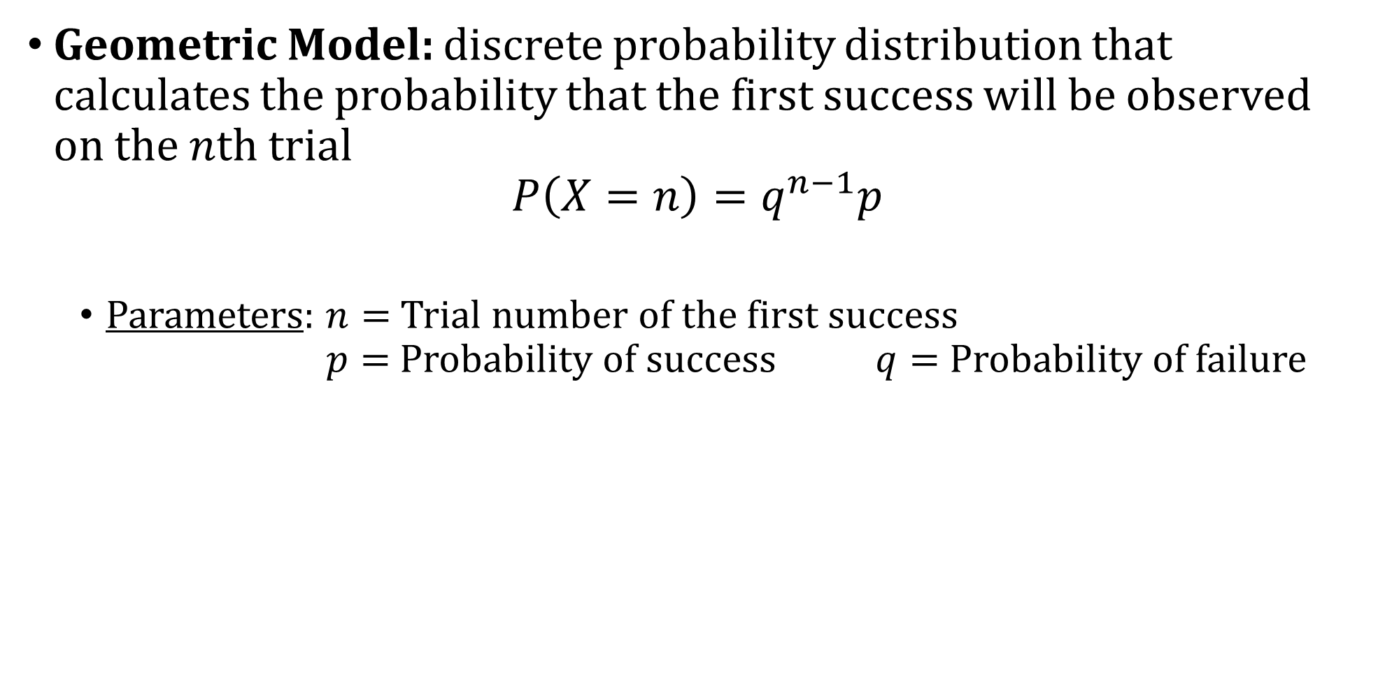
Geometric Model
Geometric Model: discrete probability distribution that calculates the probability that the first success will be observed on the $n$th trial
$$P\left(X=n\right)=q^{n−1}p$$
Parameters: $n=$ Trial number of the first success $p=$ Probability of success $q=$ Probability of failure
Difference Between Binomial and Geometric Models
Binomial: Know how many trials are being run; count number of successes observed
Geometric: Waiting for the first success; do not know how many trials it will take

Slide 18
Example: Geometric Model
Scenario: During his career, Sidney Crosby has scored on 14.6% of his shots.
Question: What is the probability that his first goal will come on his fourth shot of a game?
Answer:
Question: What is the probability it will take him more than 2 shots before scoring a goal?
Answer:

Slide 19
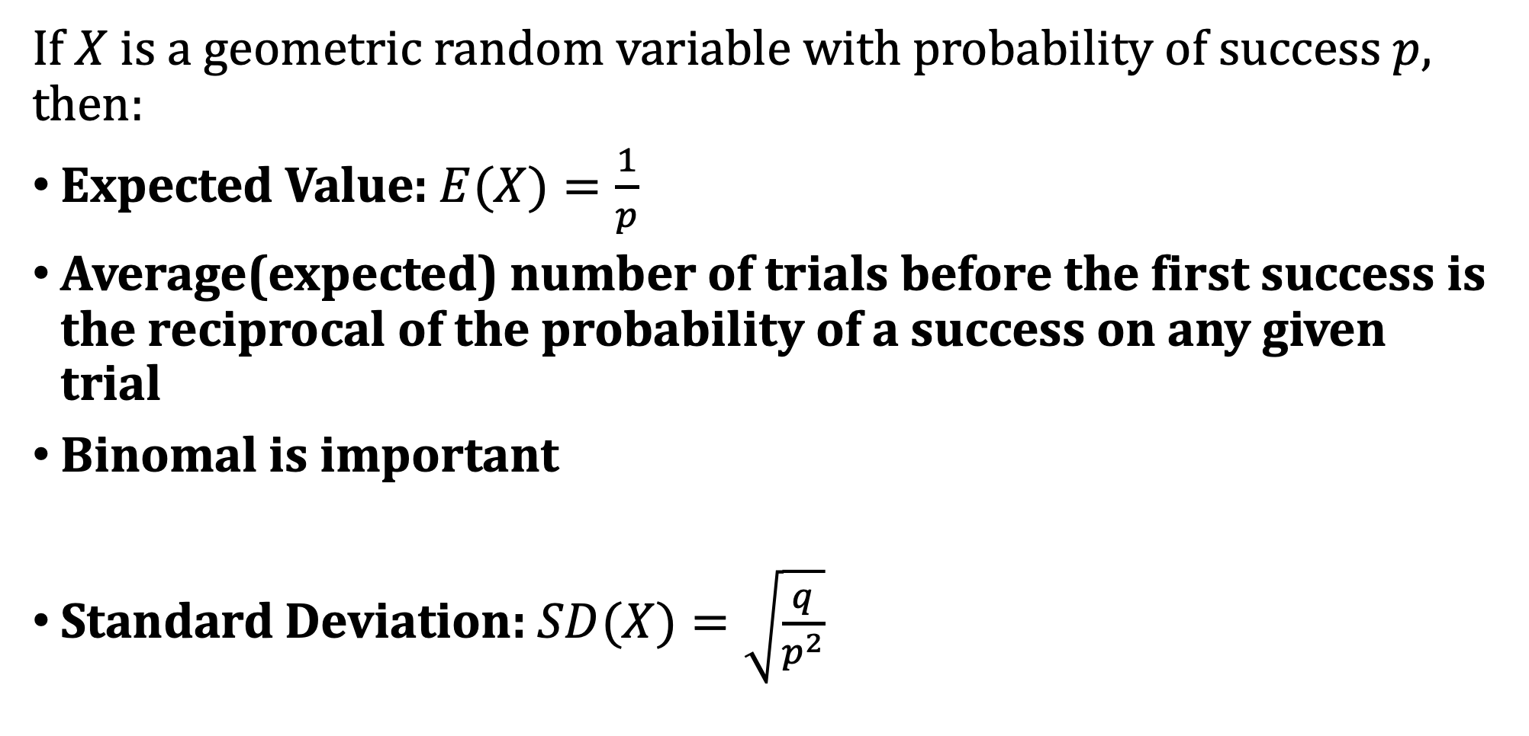
Mean and Standard Deviation
If $X$ is a geometric random variable with probability of success $p$, then:
Expected Value: $E(X)=\frac{1}{p}$
Average(expected) number of trials before the first success is the reciprocal of the probability of a success on any given trial
Binomal is important
Standard Deviation: $SD(X)=\sqrt{\frac{q}{p^{2}}}$

Slide 20
Example: Mean and Standard Deviation
Scenario: The probability that a professional darts player hits the bullseye is .40.
Question: What is the mean number of darts needed to be thrown before a darts player hits the bullseye?
Answer: E(x) = 1/.40= 2.5
Question: What is the standard deviation of the number of darts needed to be thrown before hitting the bullseye?
Answer: SD(X)= .60/(.40)2

Slide 21
Example: Mean and Standard Deviation
Scenario: The probability that a professional darts player hits the bullseye is .40.
Question: How unusual would it be for the first bullseye to come on the sixth attempt?
Answer:

